Slide 1
DEPARTMENT OF COMPUTER SCIENCE
GEOGRAPHICAL INFORMATION SYSTEM (GIS)
SCS3204
LECTURER 3
GIS FUNDAMENTALS
BY
Dr. Fredrick Kanobe (Ph.D)
Tel contact: 0782-592120 Emails: fkanobe@kyu.ac.ug or fred.Kanobe@gmail.com

Slide 2
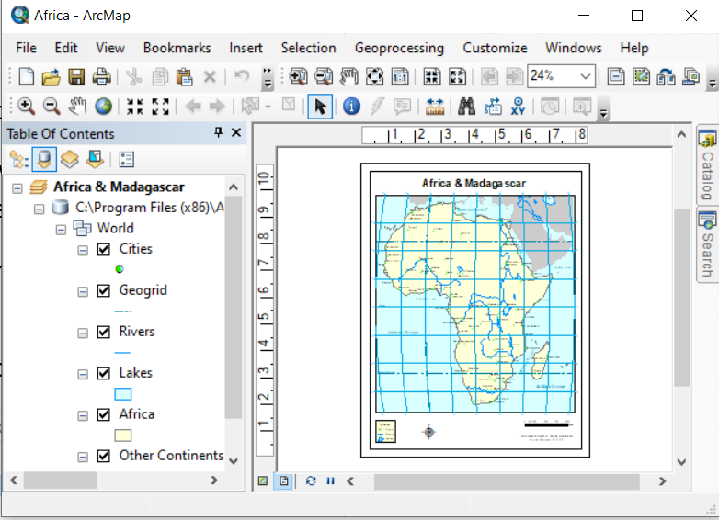
Opening an Existing Map in ArcMap
ArcGIS installs template maps that can be used in ArcMap. Some of these templates are stored in MapTemplates on your drive C. For example to open the map of Africa take the following steps:
Click File on ArcMap main menu/ program files (x86)/ArcGIS/Desktop 10.8/MapTemplates/Traditional Layouts/ World/ Africa
It opens the map of Africa as displayed below
Sample Existing Map in ArcGIS

Slide 3
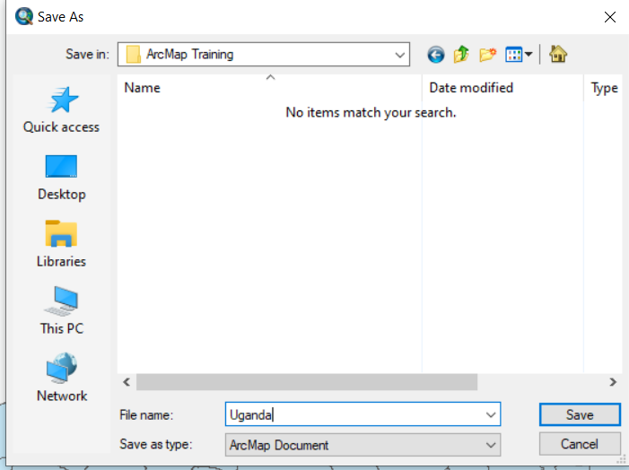
Saving a map to a new Location
ArcMap allows you to save an existing map to a new location of your choice. Create a new folder called ArcMap training. We shall save the map of Africa opened in our new created folder.
Click File on the main menu/Select Save AS/ Browse and open your new folder (ArcMap training)/type file name/ click save
Saving existing map to new location

Slide 4

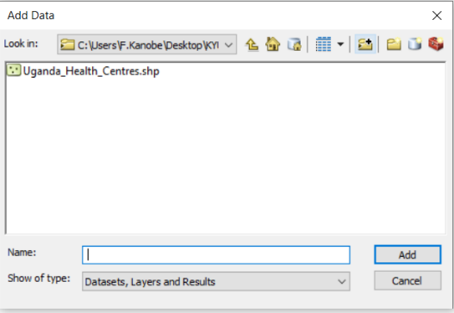
Working with Layers
Layers basically make references to data sources such as points, lines, polygons shapefiles and raster images. Map layers are commonly displayed in the table of contents (ToC). The table of contents will always appear of the left hand side of the ArcMap window.
Adding (Connecting) and Removing (Disconnecting) Map Layers in ArcMap
Click Add new data Icon
In the add Browser, click to the Connect to folder button
Browse to the folder to connect to and open the shapefile you want to open
Note: After you have done this, you will always be easily and directly connect to the data folder when searching or saving map layer.
Connect to Folder Button

Slide 5
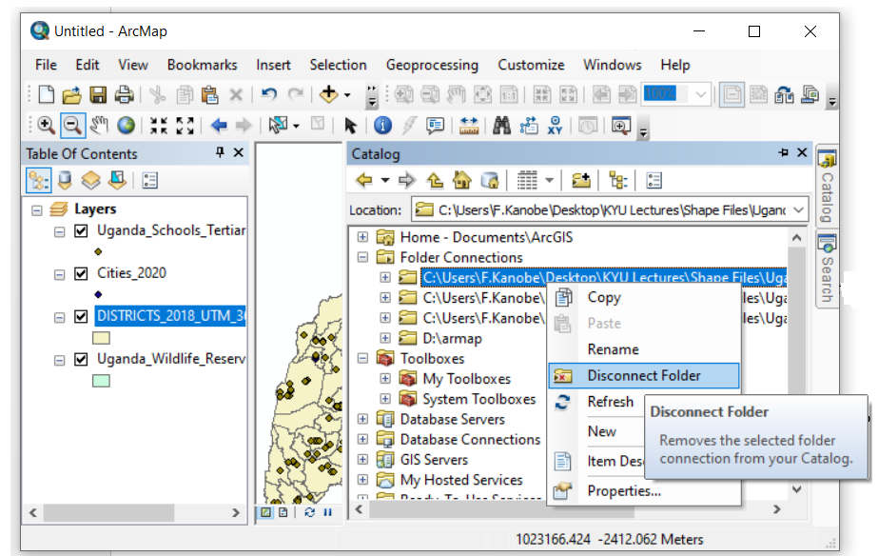
Disconnecting Map Layers
You may want to disconnect or remove your fold connection from catalog. Simply do the following:
Steps:
Open Catalog
Right Click the folder Connection you want to remove
Select Disconnect Folder
Disconnect folder Option

Slide 6
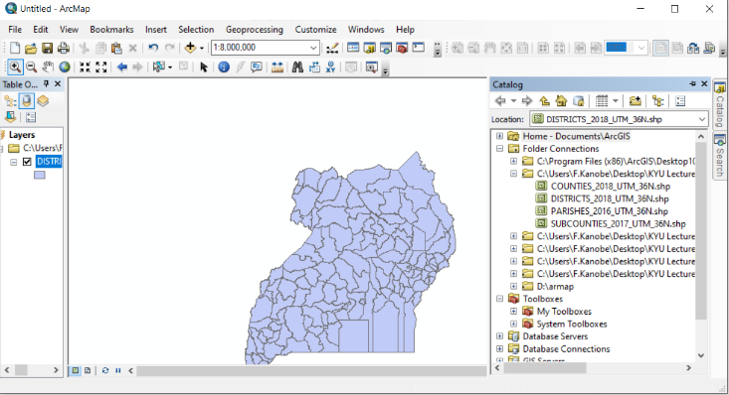
Placing Map layers in ToC using Catalog Window
The catalog window has many functions that permits users to use, explore and maintain GIS data.
One of the common operations in Catalog windows is the drag and drop once you have connected your folders containing the data.
Open Catalog window
Browse the connected folder containing the GIS data you want to view
Drag and drop the shapefile into the table of contents
Dragged Map layer

Slide 7
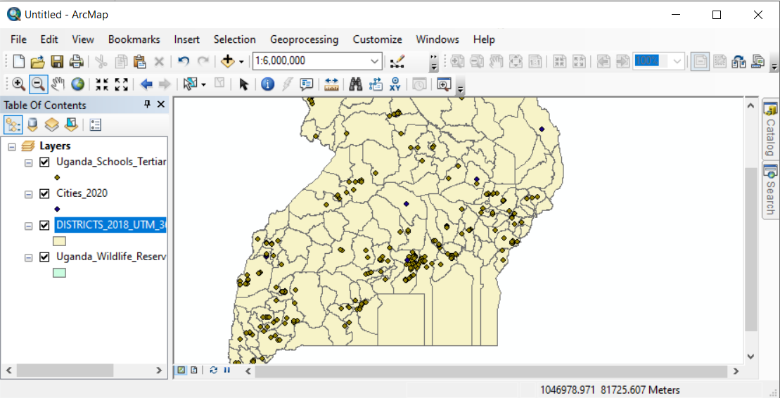
Changing the Layers Display Order
ArcMap allows users to add more than one year in the ToC in a predefined order depending on the layer that was placed in the ToC panel. Nevertheless, it permits reorganizing and change the display of layers based on the users’ preference. Steps
Open add more than two layers in the table of contents say: Uganda tertiary institutions; Uganda wild life reserves and Uganda Cities 2020.
Make sure the List by drawing Order button in the ToC is selected
Drag and drop the item you want to relocate from the current position to a new location
In the ToC change the existing map layers to appear in the following order from the top:
Uganda Wildlife reservations
Uganda School Tertiary institutions
District boundaries 2018
Cities 2020

Slide 8
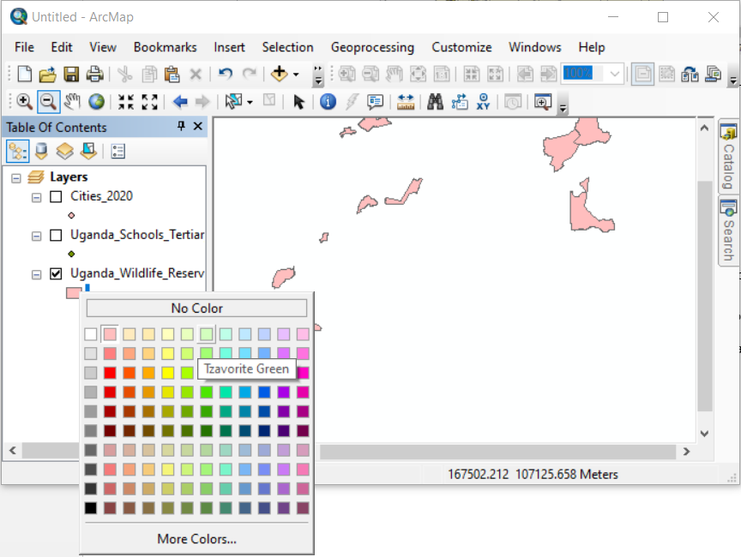
Changing the Map Layers Color and Symbols
In ArcGIS has functionalities for changing the colors and symbols of Map layers. The ArcMap users can change colors of existing Map layers to their preference and save them in new location under new file names. In the example, we shall change the color of Uganda Wild Reserve Map layer to new colors
Place the Uganda Wild Reserve in the Table of Contents using the Drag and Drop – Catalog method
Right Click the Legend below the Map layer
Select the preference color
Legend in the ToC

Slide 9
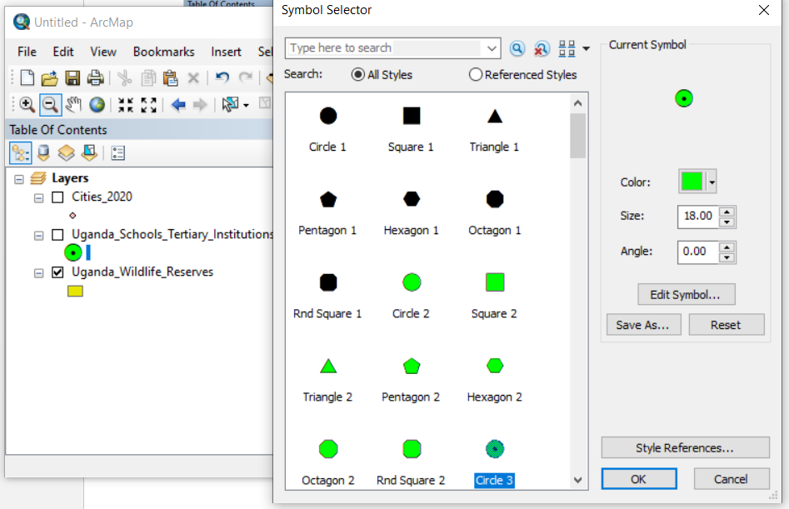
Changing Symbols using Uganda Schools Tertiary Institutions
In the previous Map layers not that Cities and Uganda schools tertiary institutions have symbols. ArcMap has functionalities that allow users to use symbols of their preference.
Place the Uganda Schools Tertiary institutions layer in the table of contents via Catalog Window
Click the Legend symbol just below the name of the opened Map layer
A new windows of symbols is displayed indicating the current symbol. Select a new symbol you want to use and click OK
Current Symbol
Symbol Options

Slide 10
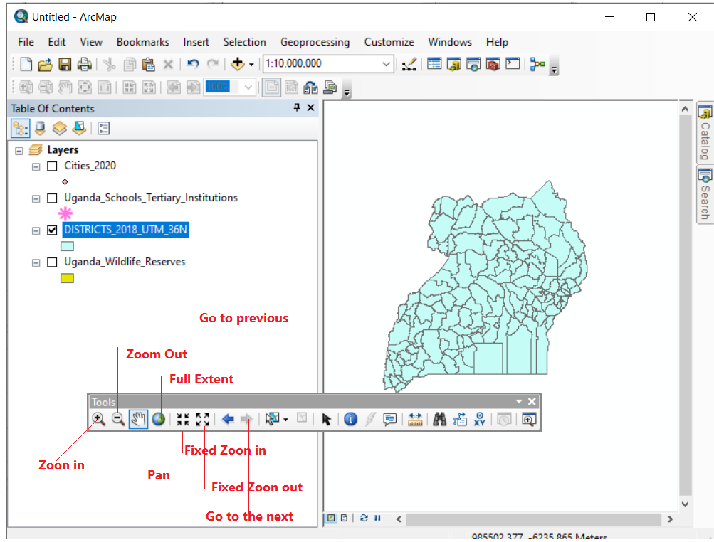
Navigating your Map in ArcMap
By default map layers are displayed in the ToC in full view extent format. ArcGIS however, permits users to zoom in, zoom out and including use of other functionalities to move around your map.
Place the Uganda Districts 2018 Map layer in the ToC via Catalog, it opens in full extent view
Use the navigation functions to explore your layer as follows:
Note
Zoon In
Zoon in by clicking the Once
Zoom Out
Zoon out by Clicking Once
Fixed Zoom in
Fixed Zoom in zooms in a fixed distance from the center of the current display
Click the map to zoom a centered on the point you click

Slide 11

Fixed Zoom Out
Fixed Zoom out zooms out a fixed distance from the center of the current zoomed display
Pan
Pan shifts the current map display without altering the current map scale
Click the Pan Button
Move the course anywhere into the map display
Hold down the left mouse button and drag the mouse in any direction
Full Previous and Next Extent Views
Full Extent – Displays all layers in the ToC regardless whether they are turned on or off. Click the full extent button
Previous Extent - It returns the map to its previous extent. Use to Previous extent Button move the map to its previous extent
Next Extent – This moves forward to the sequence of zoomed extents you have viewed. Use the next extent Button to move the next extent.

Slide 12
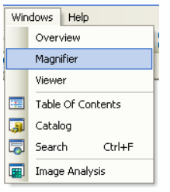
Additional Navigation Functions in ArcMap
ArcMap provides three additional map windows to view the spatial data on your map:
Magnifier window - The Magnifier window works like a magnifying glass: as you pass the window over the data, you see a magnified view of the location under the window
Viewer window - A Viewer window behaves like an independent view onto the map, and you can use any of the ArcMap interactive tools inside the window.
Overview window. The Overview window uses a box to show the extent of your display view within the total extent of your data. You can use the Overview window to navigate the map in the Data view display.
Note
Windows Overview, Magnifier and Viewer are only active in when Map layer is in Data view mode. Hence cannot be used in Data Layout

Slide 13
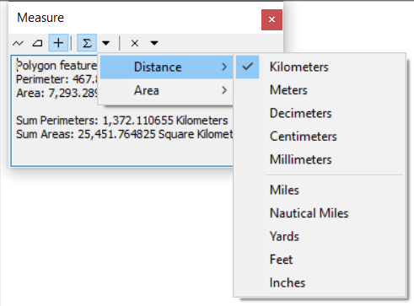
Measuring Distance on a Map
Maps have coordinates that enables users to measure distance along their paths using a mouse and course. However, while map coordinates are in specific units such as meters , the user can change the default unit to units of preference and may be applicable in particular situation.
How to change Measurements
Open Map of Uganda showing districts 2018
Click in Full Extent
On the Tools Bar select Measure
Place your cursor in ArcMap Window
Select Choose Units.
Select the new unit to be used
Note that the current Unit in use will have
a right Mark √. Select the unit you want to
use
Measure
Current Unit

Slide 14
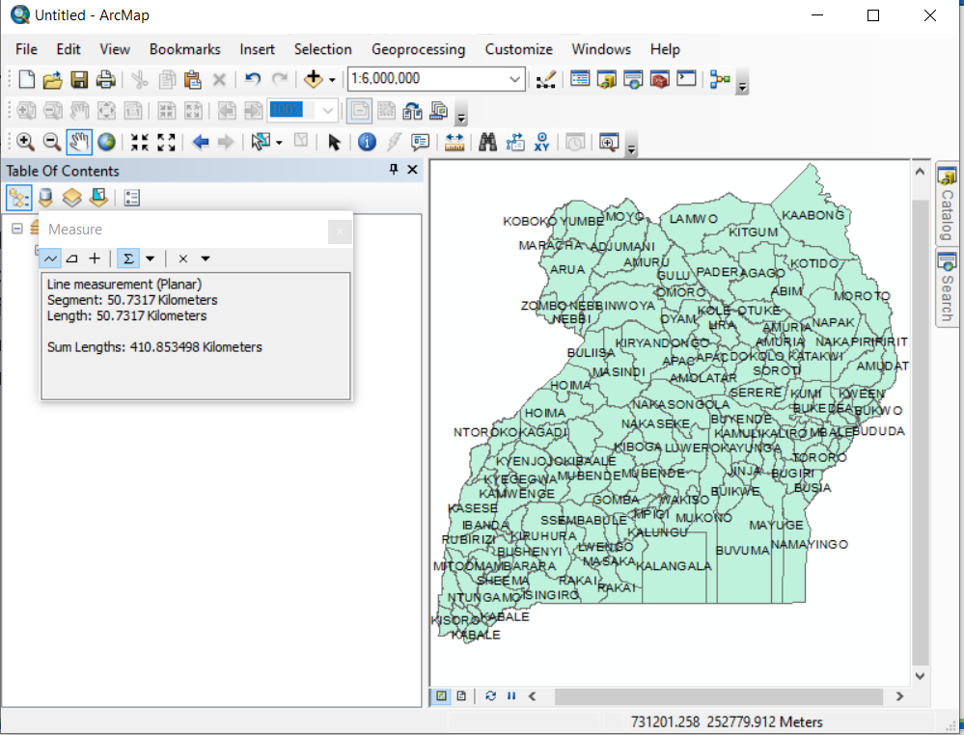
Measuring the Distance of a District on a Map
In the map of Uganda showing 2018 districts, we are going to measure the length of Kasese District.
Steps:
Open the Uganda Map 2018 districts
Select Full Extent display
Change the Unit of distance measure in KM
Select measure Line
Move the Mouse in a straight Line from the beginning to the edge of Kasese district and thereafter double click
Close the Measure Window
Length of Kasese District in KM

Slide 15
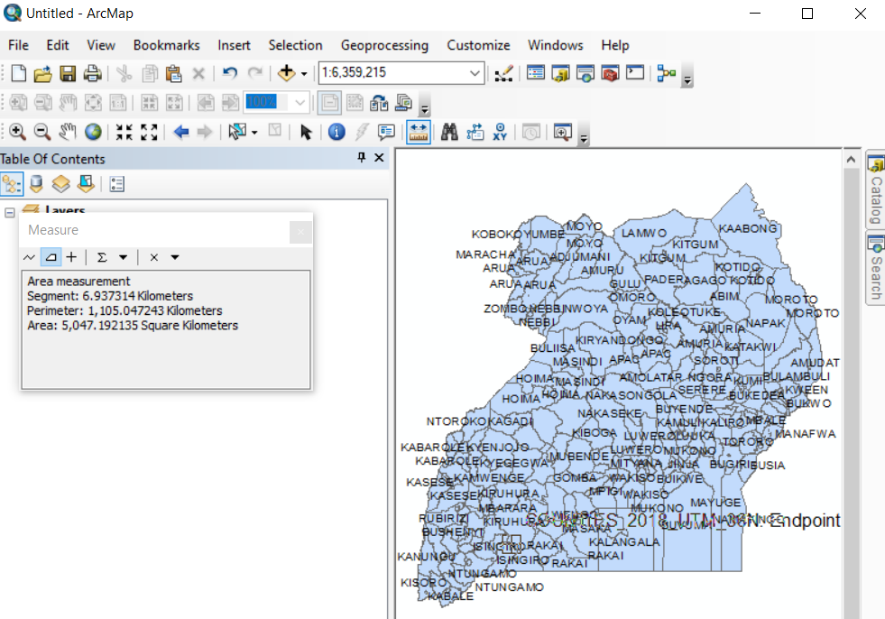
Measuring An Area on a Map
In the map of Uganda showing 2018 districts, we are going to measure an Area of Kabong District.
Steps:
Open the Uganda Map 2018 districts
Select Full Extent display
Change the Unit of distance measure in KM
Select measure Area
Move the Mouse to the Area of the district you want to measure thereafter double click\
Close the Measure Window
Measure of Area

Slide 16
Using Identifier in ArcMap
The identifier helps users of ArcMap to find detailed information about a feature displayed in ArcMap, The identifier is located on the Tools toolbar. The Identify tool allows you to see the attributes of your data and is an easy way to learn something about a location in a map.
Clicking the Identify tool on a location inside a data frame will present the attributes of the data at that location. When identifying features with the Identify tool, the attributes are presented in a feature-by-feature, layer-by-layer manner in the Identify window.
Steps
Open the may layer containing the features to be identified
Click Identifier on the Tools toolbar
Click in the Map containing to features to be identified (Buvuma District)
Identifier

Slide 17
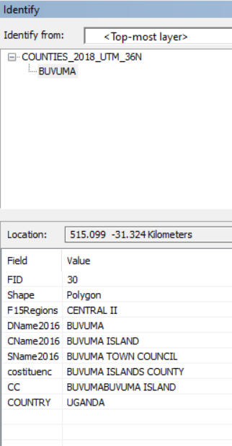
Sample Identifier details for Buvuma District in Uganda

Slide 18
Finding Features in Map Layers
Using the find toolbar on the Tools bar, users of ArcMap can discover features and attributes of Map Layers in the ArcMap window. The find tool can as well be used to flash the feature, zoom, select, unselect and identify. We shall use the Uganda Counties Map layer to demonstrate this function.
Steps:
Open Uganda Counties Map Layers via the catalog Window
Click Find located on the Tools Bar.
Type Jinja in the find and Click Find.
Jinja County and all its attributes are displayed
Right Click any of the features for example JinjaButembe and apply the following functions one after another:
Flash
Zoom
Pan to
Identify
Select
Unselect

Slide 19
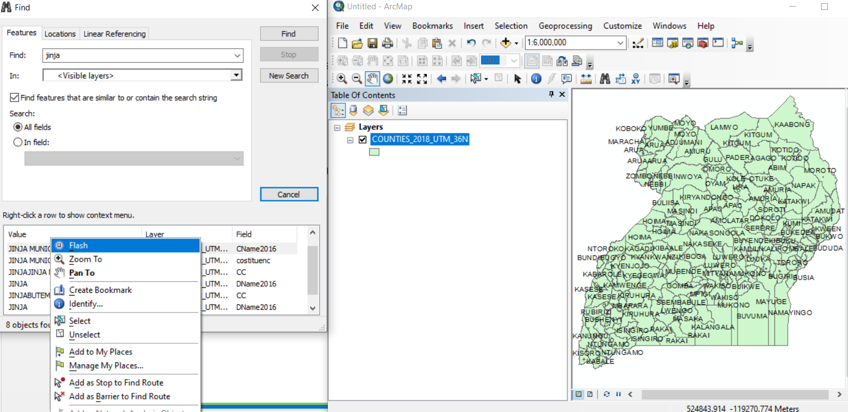
Illustration of Find function in ArcMap
Attributes of the feature
Additional functions

Slide 20
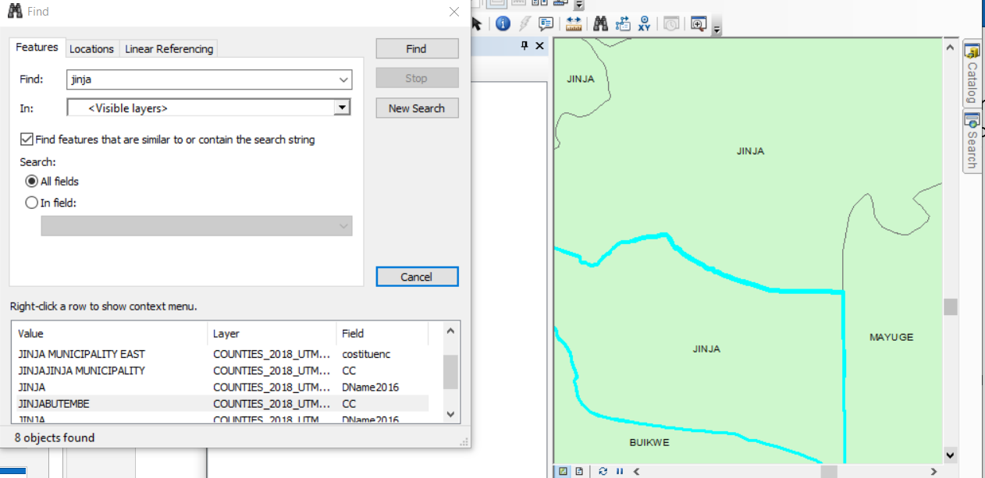
Illustration of Zoom and Selection of JinjaButembe

Slide 21
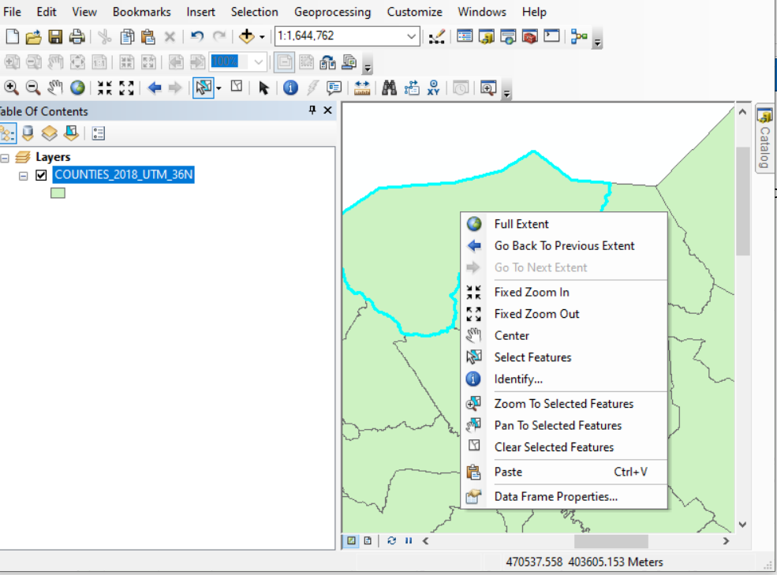
Select Function in ArcMap
The select function can be used to highlight subset of features on your map to use in subsequence exploration or analysis of data. Other functions such as Zoom in, Zoom Out, identify can be applied also the selected sub features of your map
Steps
Open Uganda District Borders Map
Choose Select tool on the tools Bar
Click any of the districts in the Map of Uganda
Note that it is high lighted
Right click the selected area and try to Zoom in, Zoom Out, Identify

Slide 22


